Slide 1



Klodo Garments
WHERE STYLE MEETS COMFORT
"Elevate Your Style Game”

Slide 2


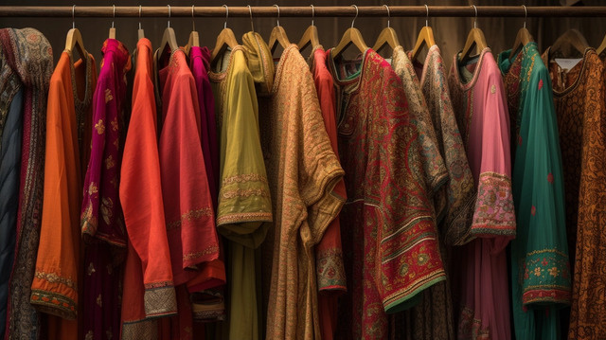
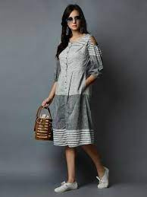
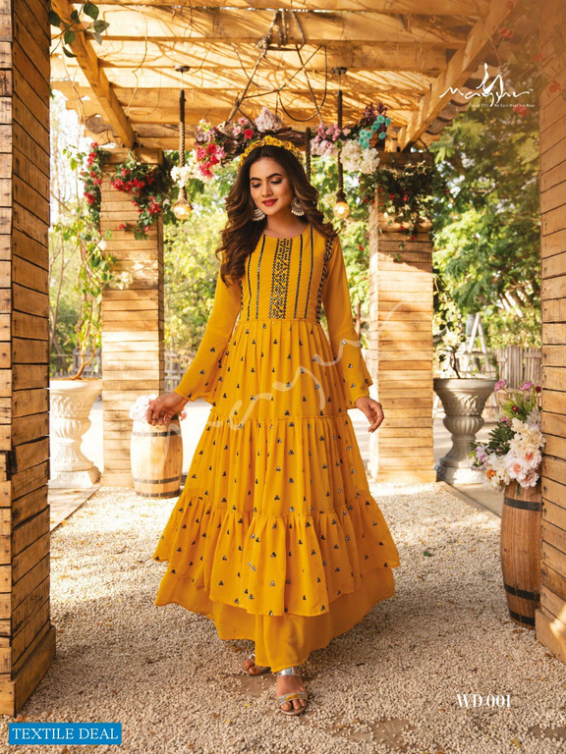
Klodo Garments
Designer Kurtis
Western
Ethnic

Slide 3
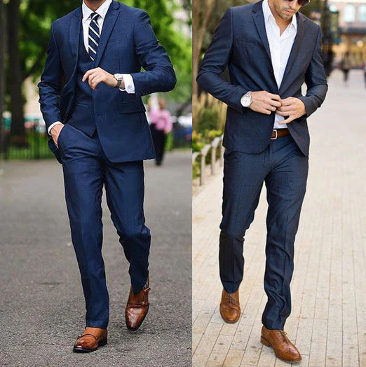
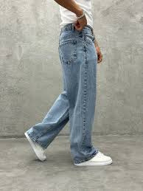
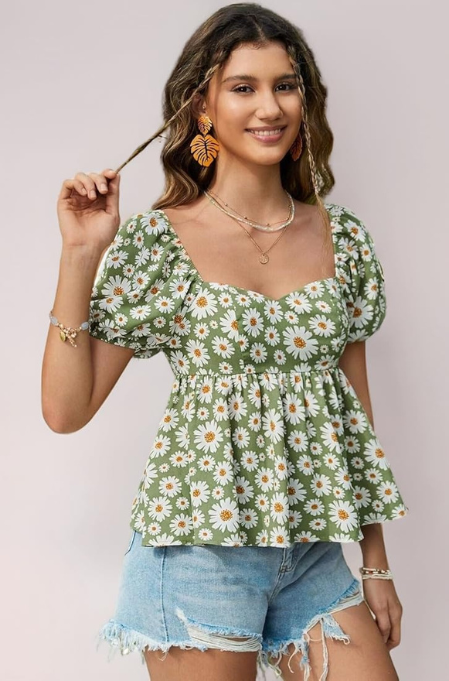
Klodo Garments
Formals
Bottoms
Floral Tops

Slide 4

Project Overview
The Klodo Garments Store Data Analysis project aims to provide valuable insights into the store's performance, sales trends, and customer demographics. By utilizing Excel's data analysis and visualization capabilities, this project transforms raw data into meaningful information. The dataset consists of various columns, including order details, customer information, sales figures, and product-related information.

Slide 5
KPI’s
Compare the sales and orders using single chart
Who purchased more - Men or Women?
Which month got the highest sales and orders?
What are different order status in 2022?
List top 10 states contributingto the sales?
1.
Highest selling category?
Which Channel is contributing maximum to the sales?
Relation between age and gender based on number of orders.

Slide 6
Processes
Verify data for any missing values and anomalies, and sort out the same.
Made sure data is consistent and clean with respect to data type, data format and values used.
Created pivot tables according to the questions asked
Merge all pivot tables into one dashboard and apply slicer to make dashboard interactive (clickable) and dynamic.

Slide 7


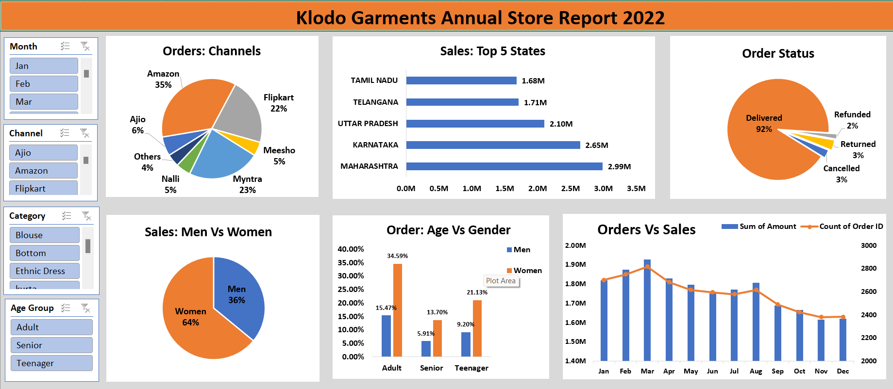
Dashboard

Slide 8
- Women customers are more likely to buy products compared to men (~65%).
- The states of Maharashtra, Karnataka and Uttar Pradesh are the top 3 product buyers
Project Insights
- The adult age group (30-49 yrs) is max contributing (~50%) and buys the most products.
- The maximum number of products customer orders from Amazon, Flipkart and Myntra channels.

Slide 9
Conclusion
To improve sales of Klodo Garments Store, women customers of the age group (30-49 yrs) living in Maharashtra, Karnataka and Uttar Pradesh must be targeted by showing ads/offers/coupons available on Amazon, Flipkart and Myntra.

Slide 10
Thank You

